Slide 1
Edge Computing
Lecture 06: Quantization and Pruning

Slide 2
Recap
Neural network: terminology
Neuron, Synapse, Activation, Weight, etc.
Common building block: layer
FC, Conv, Conv2D, Depthwise Conv
Receptive field, padding, strides
Pooling, Normalization
Convolution neural network
Alexnet, VGG16, MobileNetv2
Tensorflow, Tensorflow Lite

Slide 3
Agenda
Pruning
What and why?
How? Pruning criterion
Fine-tune/retrain acceleration
Quantization
What and why?
Linear quantization
Quantization granularity
Calibration and Clipping

Slide 4
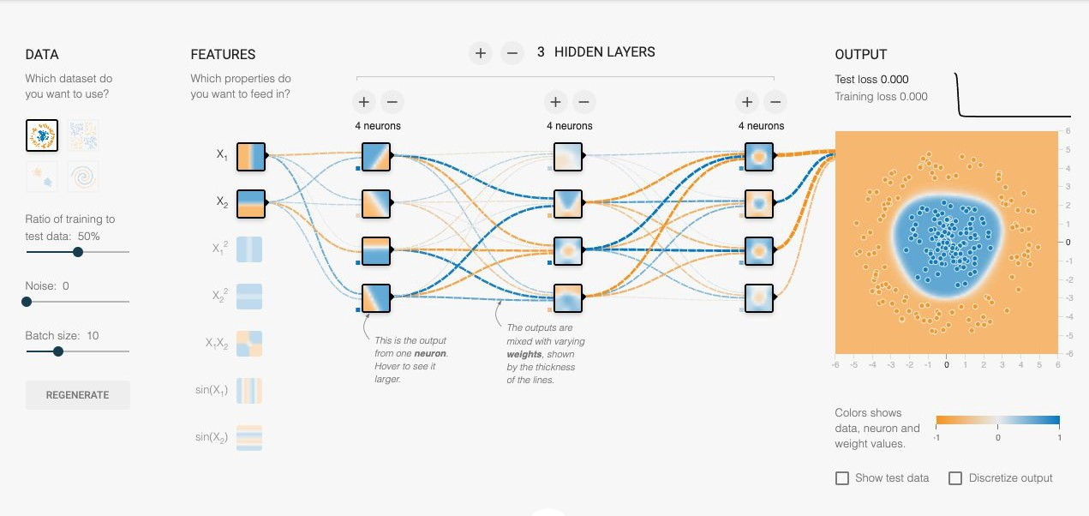
What is Pruning?
Shrinking models by removing synapses and neurons.

Slide 5
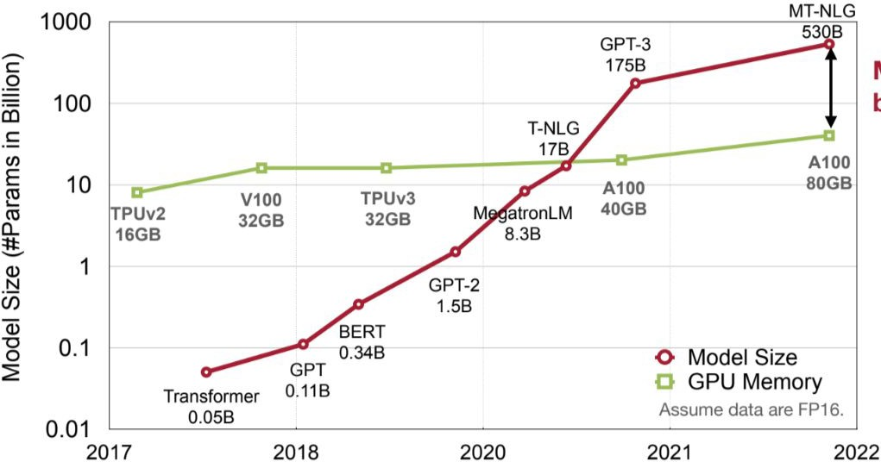
Why pruning?
https://hanlab.mit.edu/courses/2023-fall-65940

Slide 6
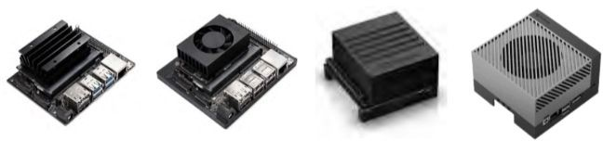
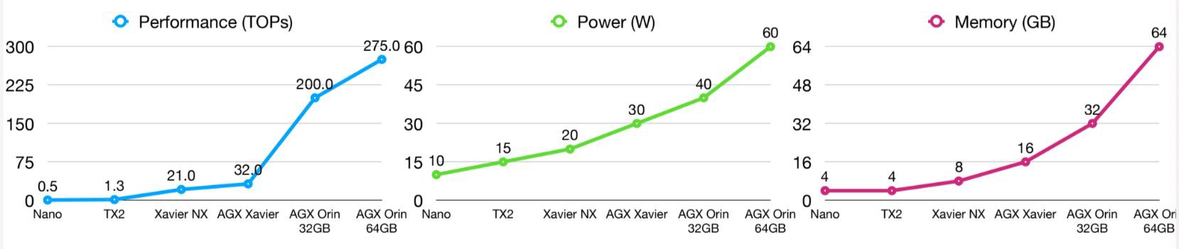
Why pruning? Model Footprint
Nvidia Jetson
Custom boards vs Dev boards
Nano
Xavier
AGX
Xavier
Orin
https://connecttech.com/jetson/jetson-module-comparison/ & Song, Han, EfficientML.ai

Slide 7
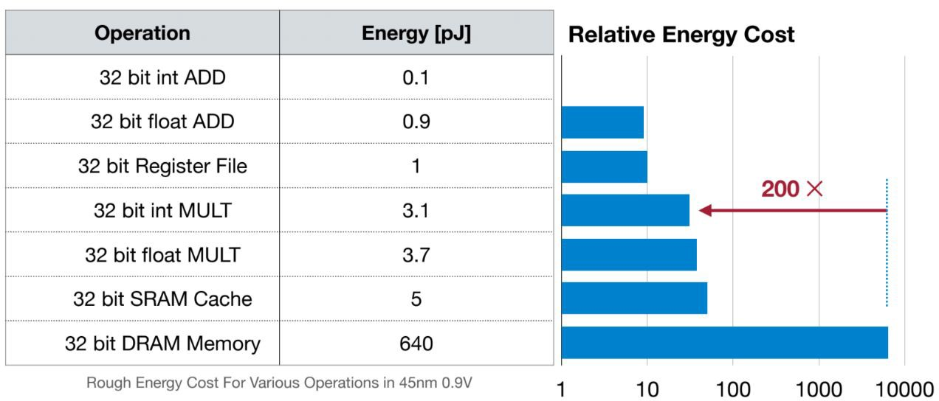
Why pruning? Energy
Computing's Energy Problem (and What We Can Do About it) [Horowitz, M., IEEE ISSCC 2014]

Slide 8
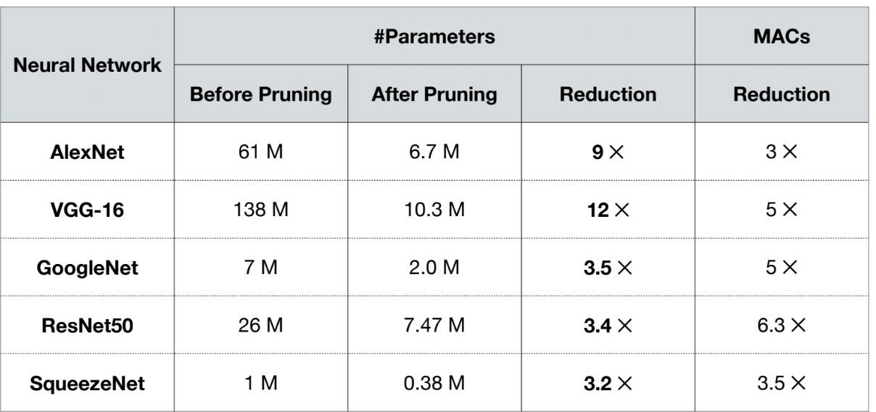
Smaller network, will it work?
MAC, Multiply-ACCumulation operations ~ FLOPS
https://hanlab.mit.edu/courses/2023-fall-65940

Slide 9
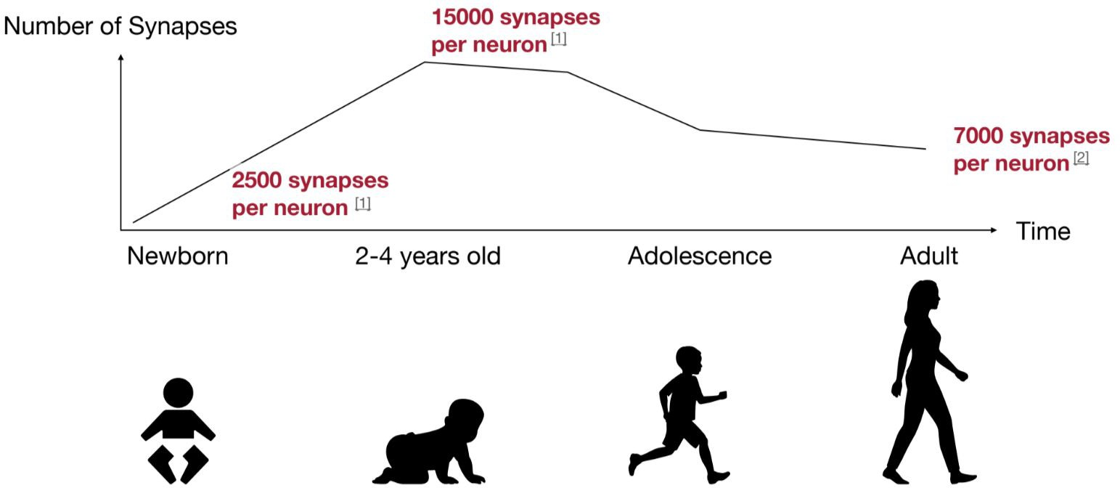
Human brain prunes too!
https://hanlab.mit.edu/courses/2023-fall-65940

Slide 10
How to prune?

Slide 11
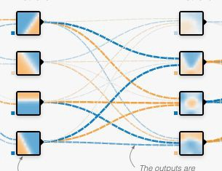
How to prune?
X
=

Slide 12
How to prune?
X
=

Slide 13
How to prune?
X
=

Slide 14
How to prune?
X
=

Slide 15
How to prune?
X
=

Slide 16
How to prune?
X
=

Slide 17
How to prune?
X
=

Slide 18
How to prune?
X
=

Slide 19
How to prune?
X
=

Slide 20
How to prune?
X
=
X
=

Slide 21
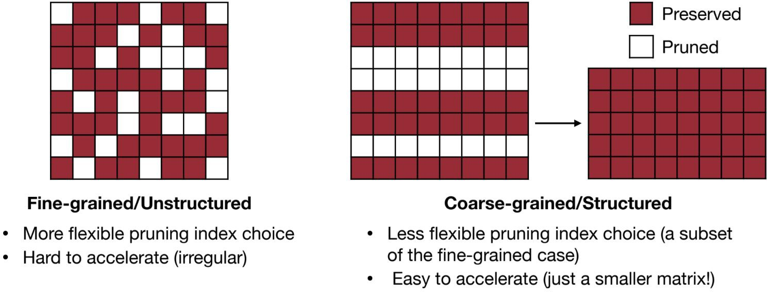
Pruning Granularity
https://hanlab.mit.edu/courses/2023-fall-65940

Slide 22
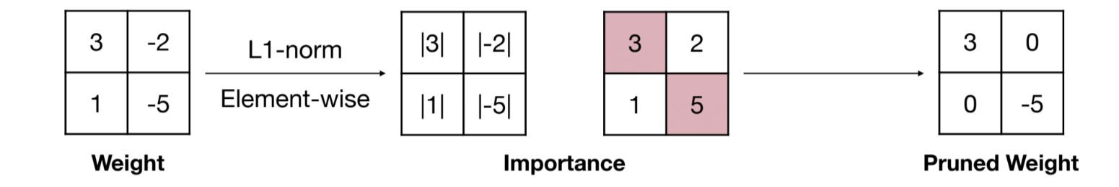
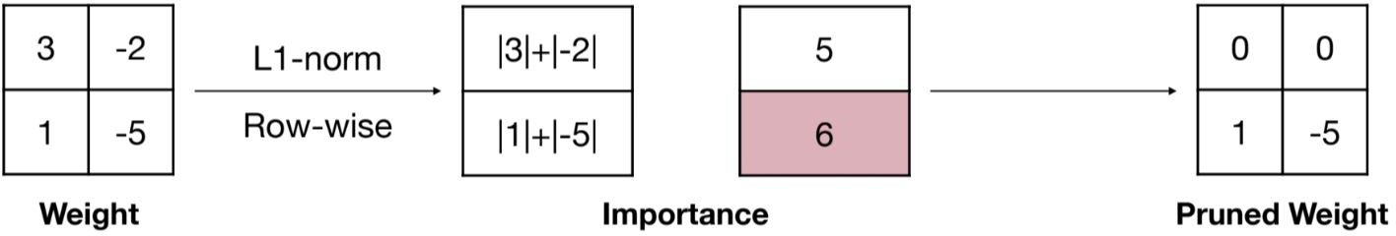
Magnitude-based Pruning
https://hanlab.mit.edu/courses/2023-fall-65940
Fine-grained
Coarse-grained / structured

Slide 23
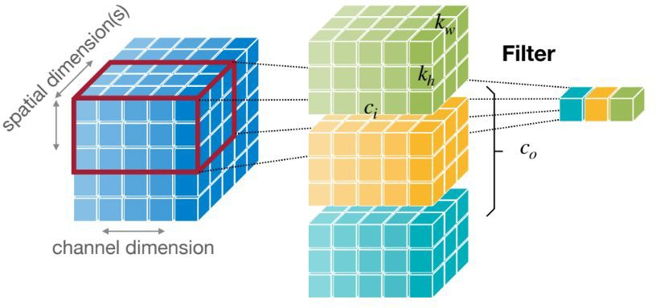
How to prune CNN?
https://hanlab.mit.edu/courses/2023-fall-65940

Slide 24
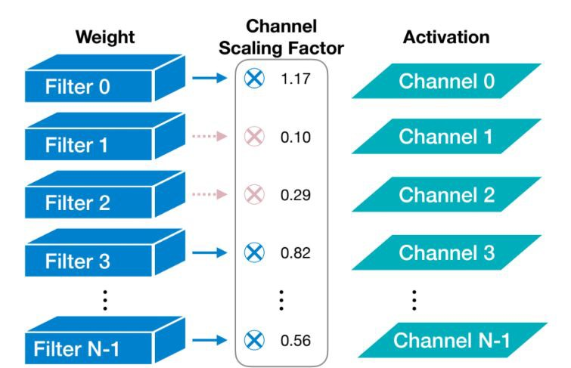
Scaling-based Pruning
Learning Efficient Convolutional Networks through Network Slimming [Liuet al.,ICCV 2017]

Slide 25
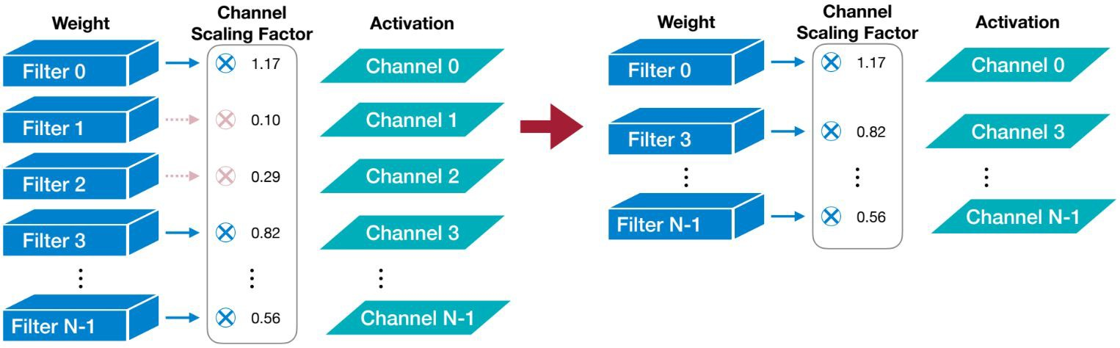
Scaling-based Pruning
?
Learning Efficient Convolutional Networks through Network Slimming [Liuet al.,ICCV 2017]

Slide 26
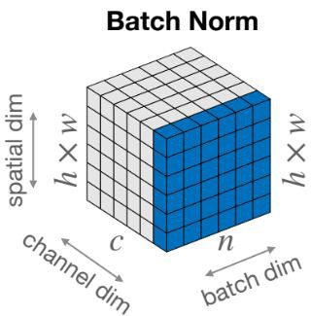
Scaling-based Pruning
Batch Normalization scaling factor
Learning Efficient Convolutional Networks through Network Slimming [Liuet al.,ICCV 2017]

Slide 27
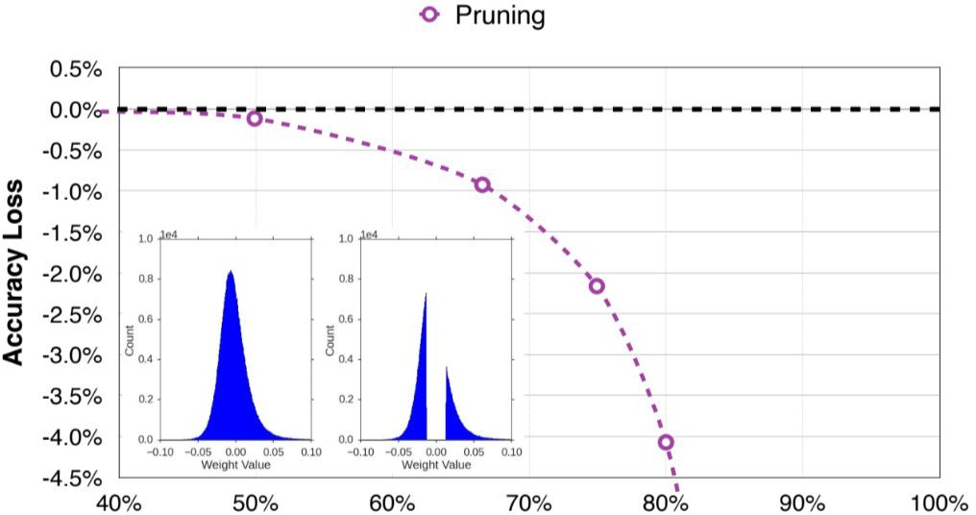
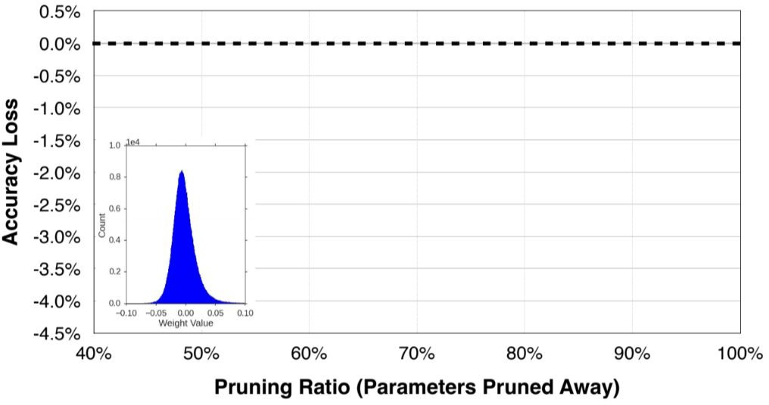
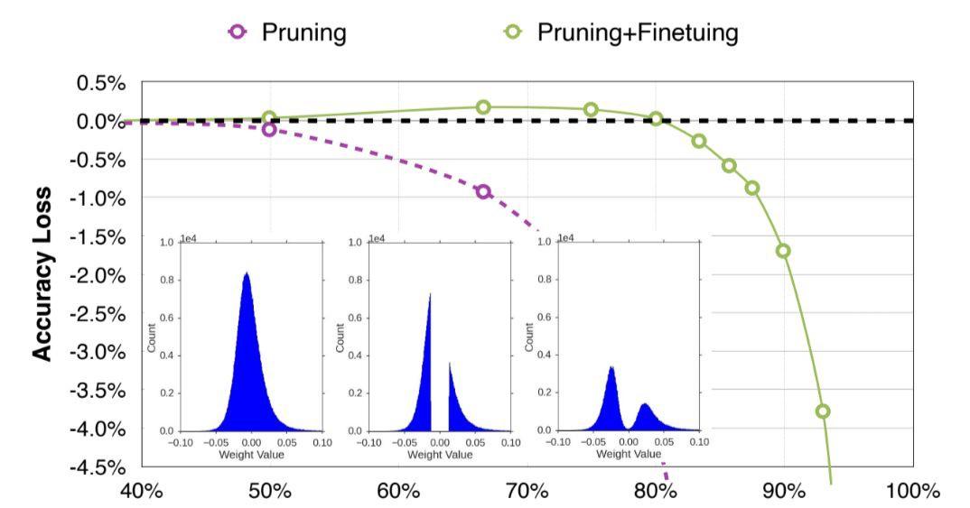
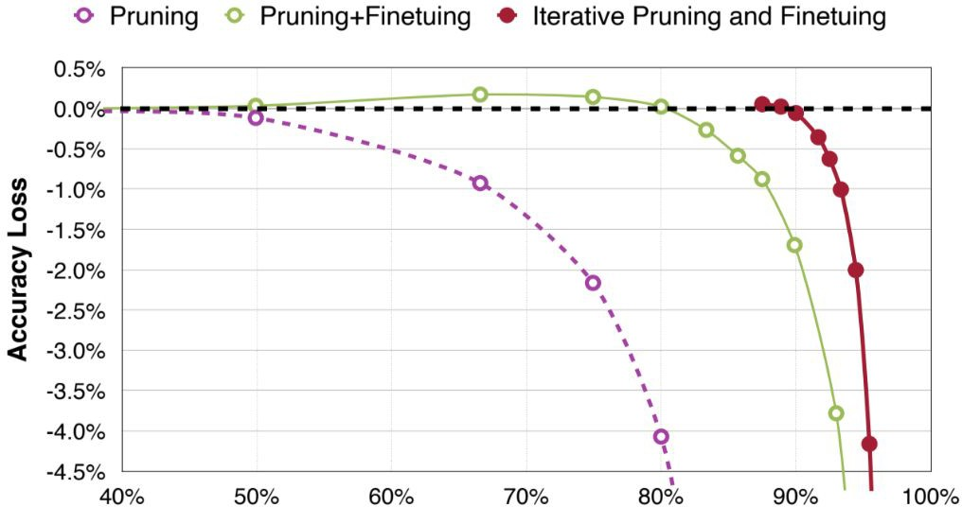
Fine-tune/Retrain (e.g. AlexNet)
Learning Both Weights and Connections for Efficient Neural Network [Hanet al., NeurIPS 2015]

Slide 28
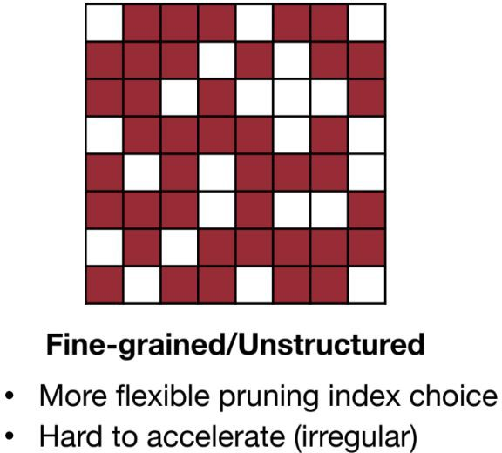
Q: How to accelerate irregular pruning?

Slide 29
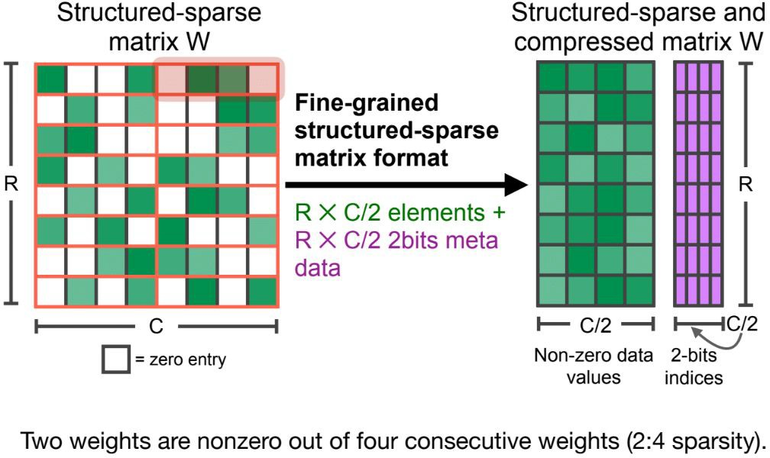
M:N Sparsity
Accelerating Sparse Deep Neural Networks[Mishraet al.,arXiv 2021

Slide 30
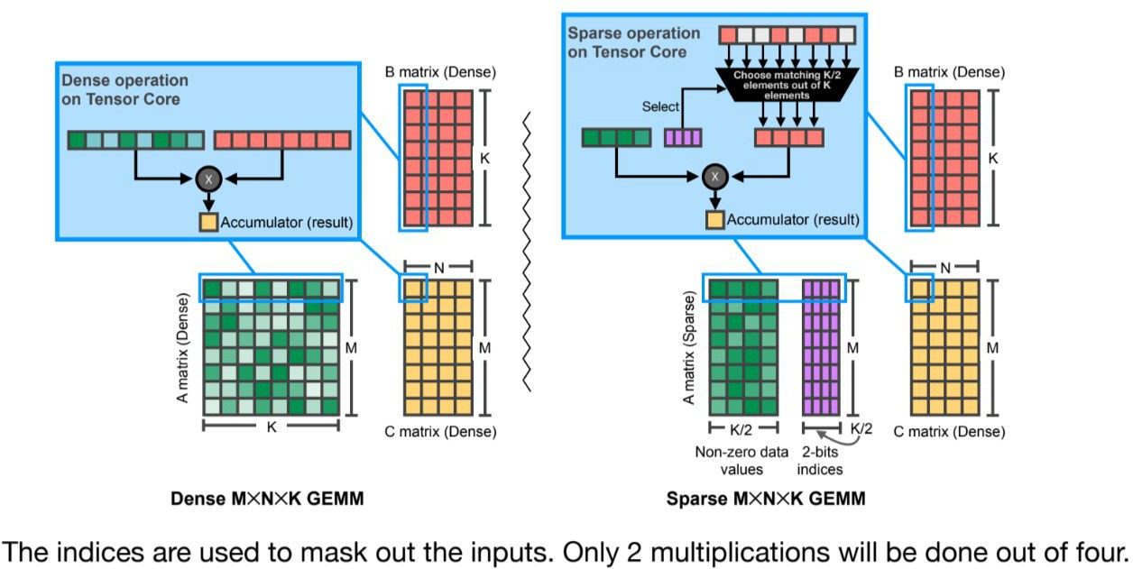
M:N Sparsity
Accelerating Sparse Deep Neural Networks[Mishraet al.,arXiv 2021

Slide 31
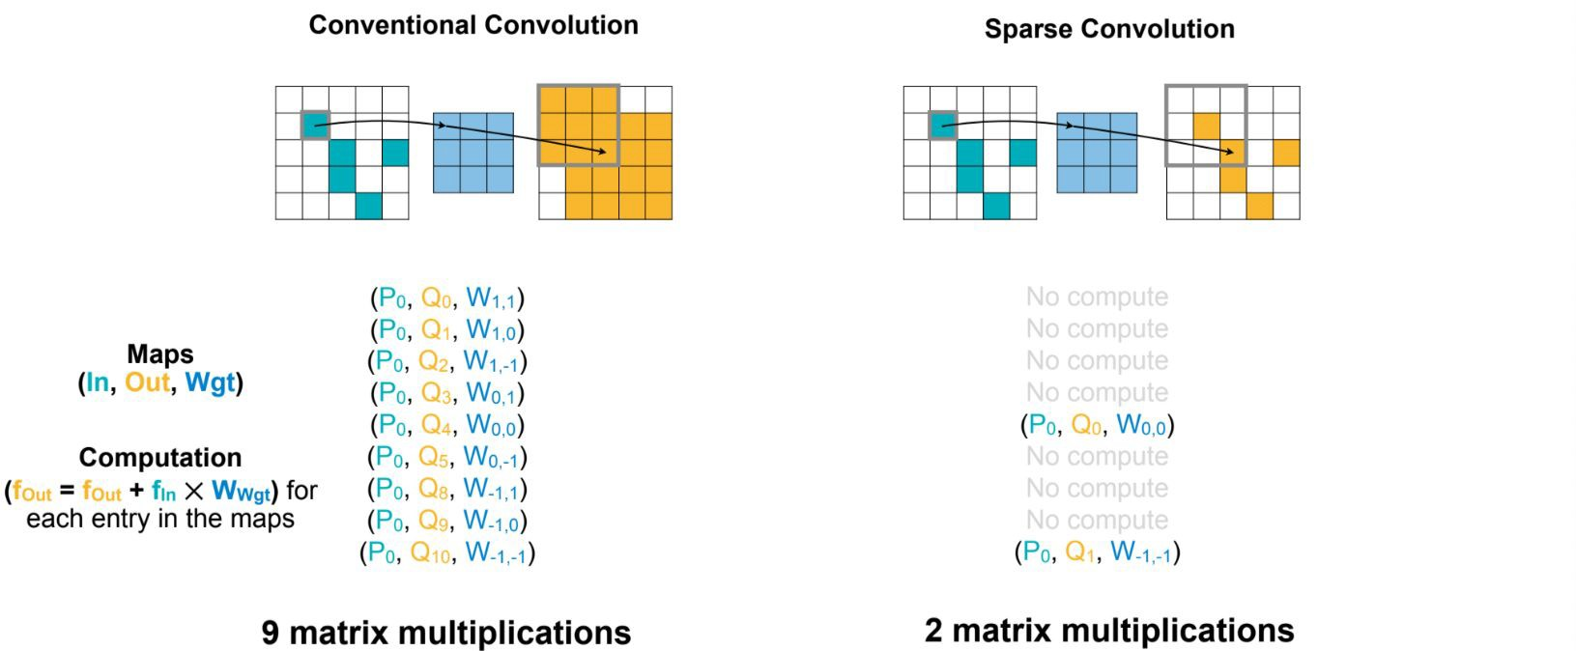
Sparse Conv
P0
TorchSparse: Efficient Point Cloud Inference Engine [Tanget al., MLSys 2022]

Slide 32
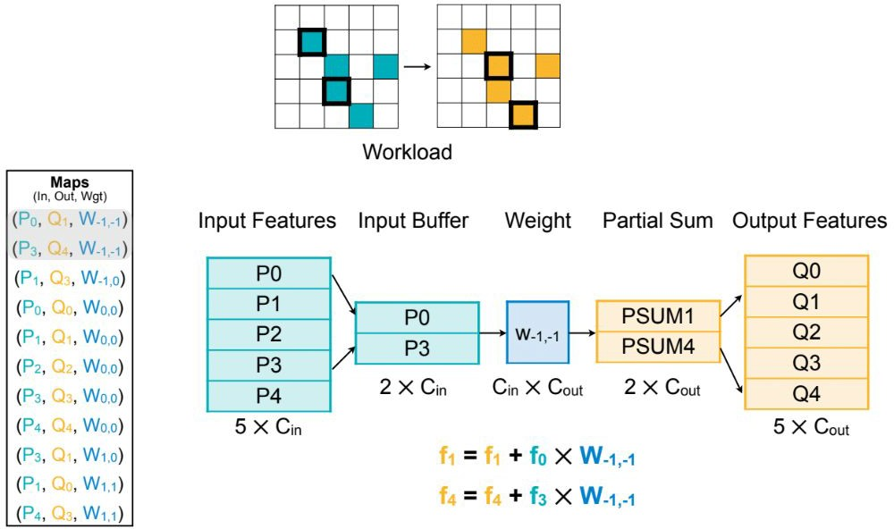
Sparse Conv
TorchSparse: Efficient Point Cloud Inference Engine [Tanget al., MLSys 2022]

Slide 33
Agenda
Pruning
What and why?
How? Pruning criterion
Fine-tune/retrain acceleration
Quantization
What and why?
Linear quantization
Quantization granularity
Calibration and Clipping

Slide 34
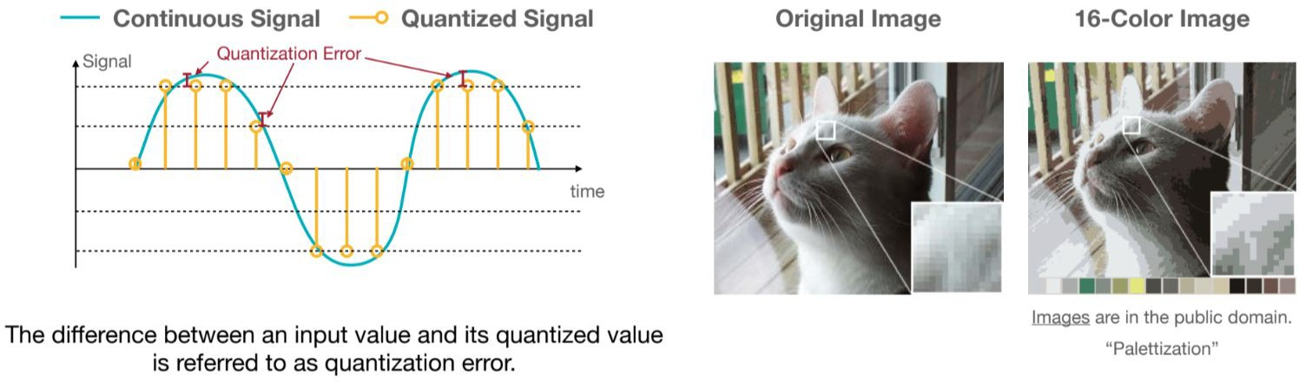
What is quantization?
Quantization is the process of constraining an input from a continuous or otherwise large set of values to a discrete set.
https://hanlab.mit.edu/courses/2023-fall-65940

Slide 35
Why quantization? Small footprint & low energy
Computing's Energy Problem (and What We Can Do About it) [Horowitz, M., IEEE ISSCC 2014]

Slide 36
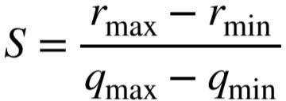
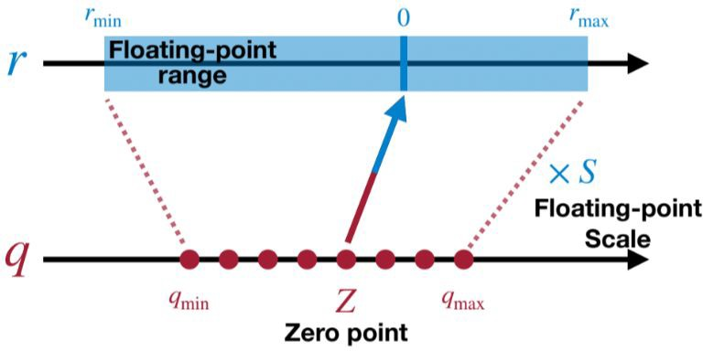
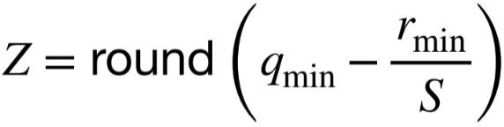
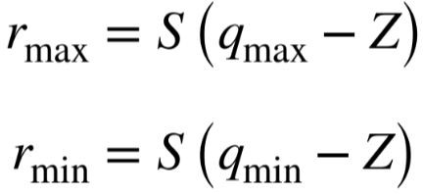
Linear Quantization
https://hanlab.mit.edu/courses/2023-fall-65940
An affine mapping of integers to real numbers
R = S(q-Z)

Slide 37
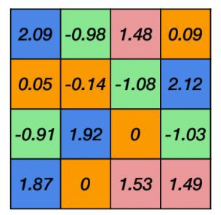
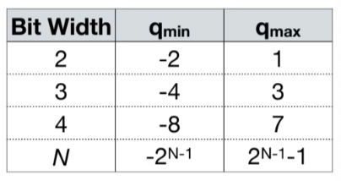
Linear Quantization: Example
https://hanlab.mit.edu/courses/2023-fall-65940

Slide 38
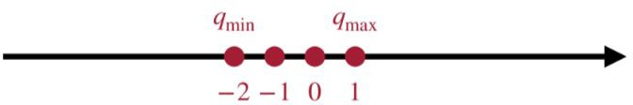
Linear Quantization: Example
https://hanlab.mit.edu/courses/2023-fall-65940
S = (2.12 - (-1.08)) / (1 - (-2))
= 1.07
Z = round (-2 - -1.08 / 1.07)
= -1

Slide 39
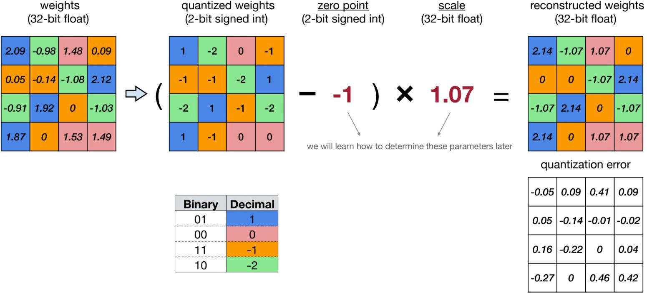
Linear Quantization
https://hanlab.mit.edu/courses/2023-fall-65940
q = round (r / S + Z)

Slide 40
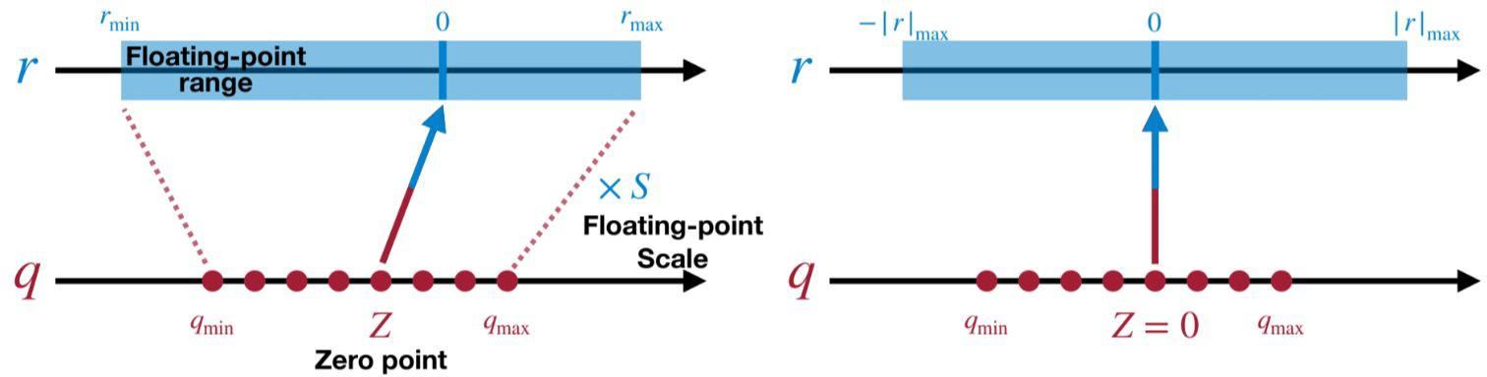
Symmetric Linear Quantization
https://hanlab.mit.edu/courses/2023-fall-65940

Slide 41
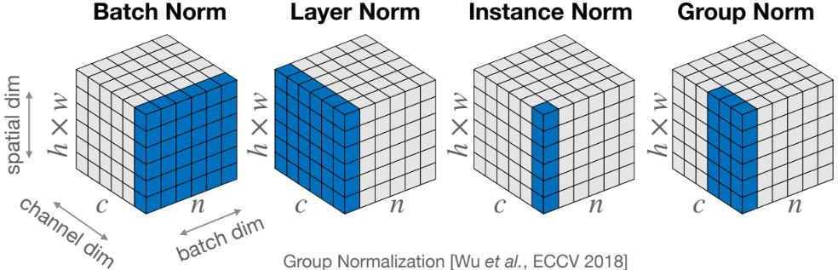
Quantization Granularity
Per-tensor quantization
Per-channel quantization
Group quantization

Slide 42
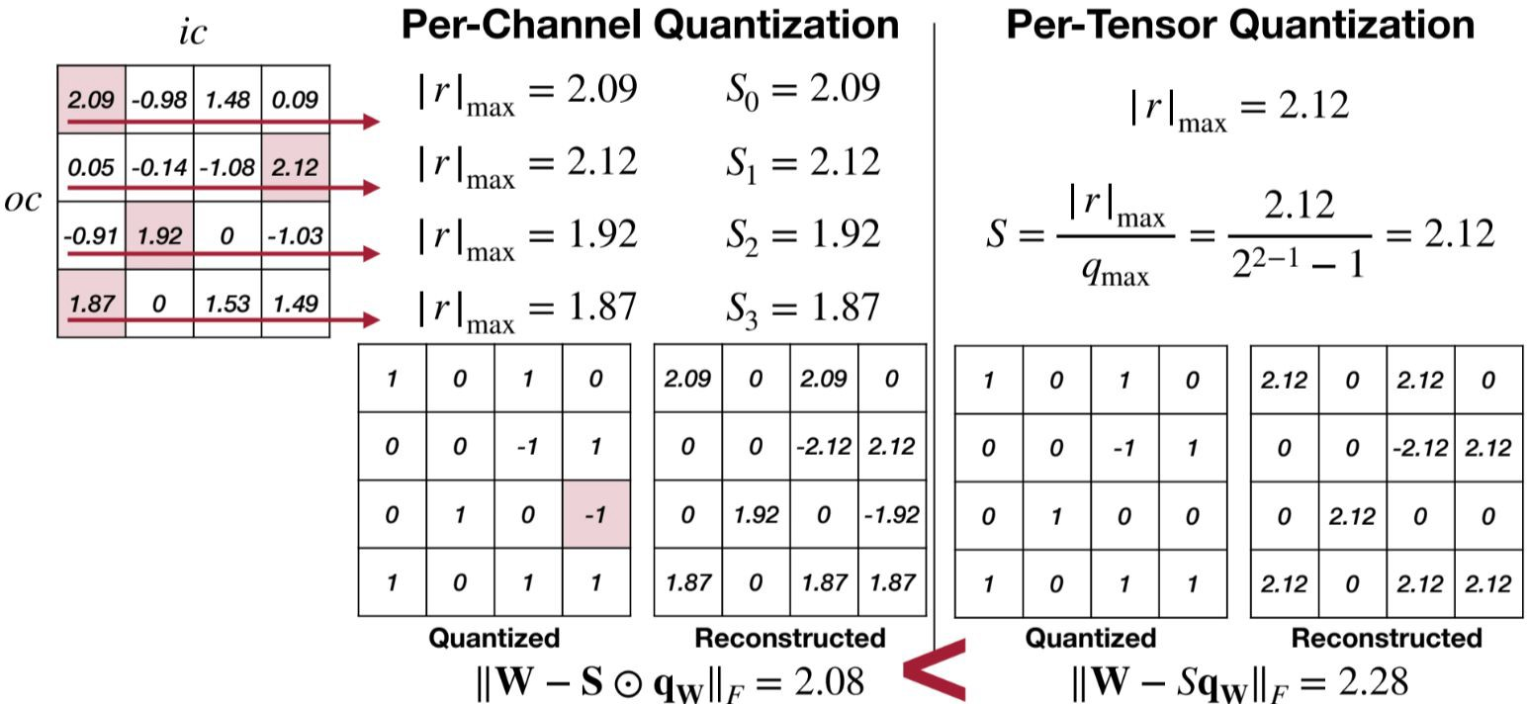
Per-channel vs Per-tensor
https://hanlab.mit.edu/courses/2023-fall-65940

Slide 43
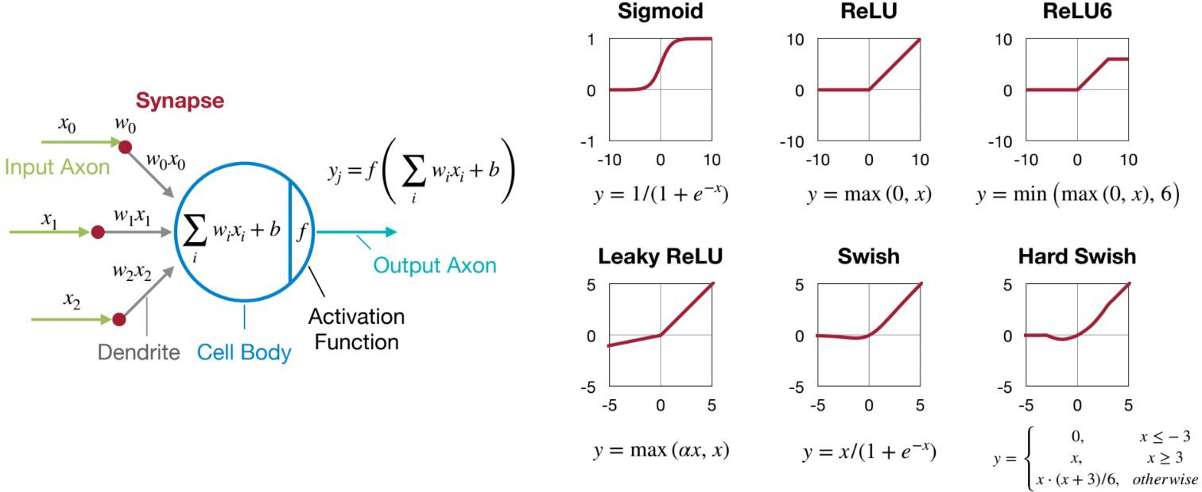
Non-static Dynamic Range
Weights has [r_min,r_max] fixed range
Activation value has unknown range
depends on input
How to determine r_min and r_max?

Slide 44
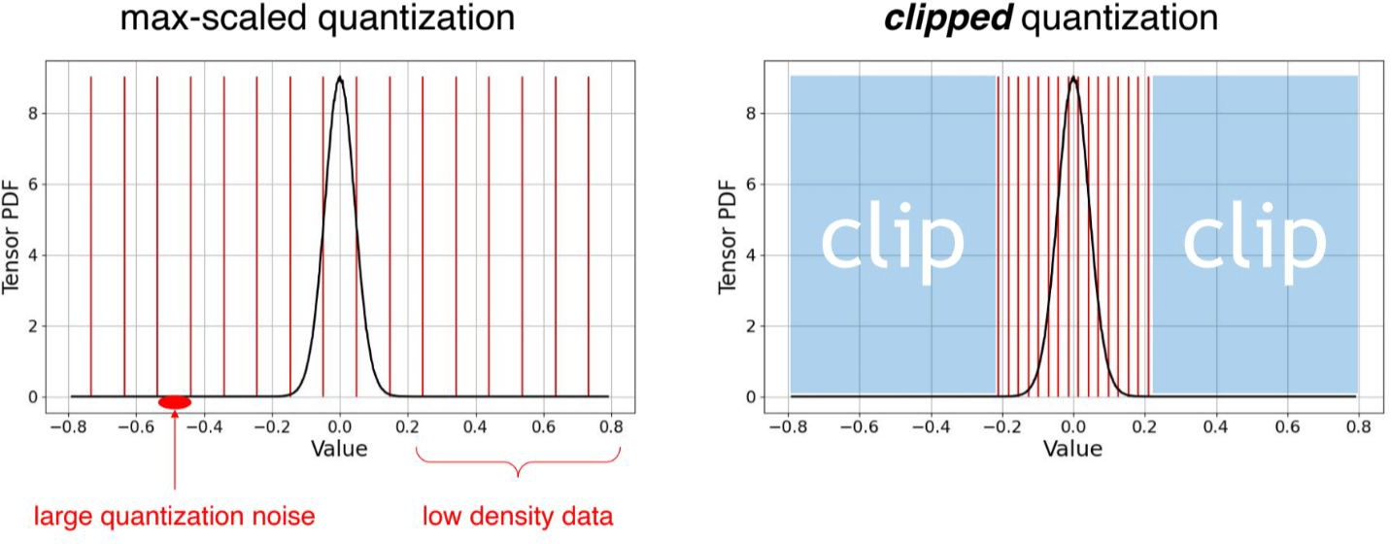
Dynamic Range: Calibration & Clipping
Run a batch of samples
Get the statistical distribution of activations
Get rid of outliers
https://hanlab.mit.edu/courses/2023-fall-65940

Slide 45
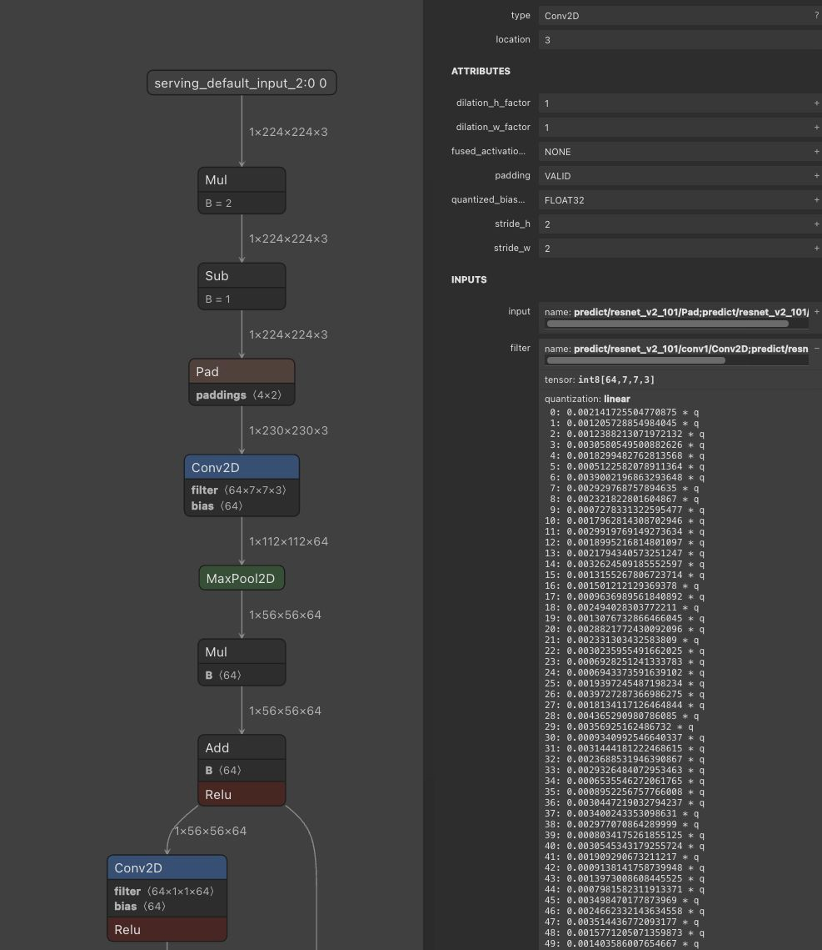
Tutorial: TF Lite quantization
Post-training dynamic range quantization | TensorFlow Lite
Visualize quantized vs unquantized model in Netron.app

Slide 46
Summary
Pruning
What and why?
How? Pruning criterion
Magnitude-based, Scaling-based
Fine-tune/retrain acceleration
M:N sparsity, SparseConv
Quantization
What and why?
Linear quantization
Scale, zero point
Quantization granularity
Per-tensor, per-channel
Calibration and Clipping

Slide 47
Next Lectures
Example paper presentation: ML-Exray
Hardware architecture
Special accelerators
Quiz on Lecture 05-06

